Slide 1
Less is More: Mitigate Spurious Correlations for Open Domain Dialogue Response Generation Models by Causal Discovery
Tao Feng and Lizhen Qu* and Gholamreza Haffari
Faculty of Information Technology Monash University, Australia
{tao.feng, lizhen.qu, gholamreza.haffari}@monash.edu
—ACL2023
Reported by Dongji Wang

Slide 2
Introduction

Slide 3
Experiments
Empirical study on spurious correlations for dialogue response generation models：

Slide 4
Conclusion
Both models do not really learn on the utterances that humans use as causes to articulate responses, but rely heavily on non-cause utterances.

Slide 5
Introduction

Slide 6
Method
Causal Discovery Background:
$u_{i}$→g$\left(u_{i}\right)$→$Z_{i}$
$Z_{i}$→$Z_{j}$
$$Z_{i} { Z}_{j}{| Z}_{t,−i}$$
$$→$$
CI（Conditional Independence Testing）
Classifier-based CI test

Slide 7
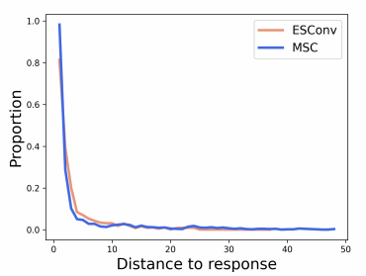
Method

Slide 8
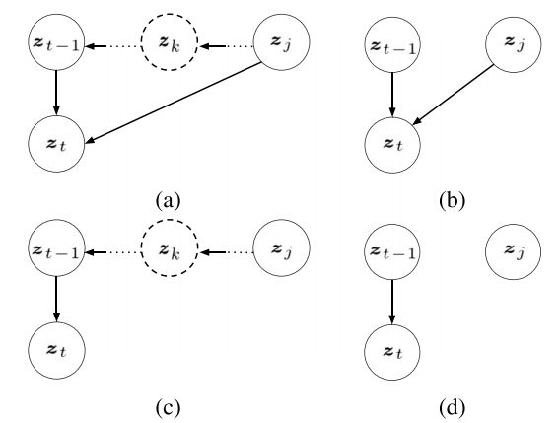
Method
Assumption 1. For each response rt, g(ut−1) →g(rt) always holds.
Assumption 2. There are at most two direct causes for the latent random variable vector of a response.
Assumption 3. If there is an edge between g(ui) and g(uj ) in a causal graph and i<j, then g(ui) → g(uj ).

Slide 9
Method
Classifier-based CI test：
$$Z_{t} { Z}_{j}{| Z}_{t−1}$$
$$→$$
L:0
p($Z_{t}, Z_{j}{| Z}_{t−1})=$p($Z_{t}{| Z}_{t−1})p(Z_{j}{| Z}_{t−1})$
$$Z_{t} { Z}_{j}{| Z}_{t−1}$$
$$→$$
L:1
p($Z_{t}, Z_{j}{| Z}_{t−1})=$p($Ζ_{t}{|Z_{j}, Z}_{t−1})p(Z_{j}{| Z}_{t−1})$
The classifier aims to capture the conditional distribution p(l|$Z_{t}$, $Z_{t−1}$, $Z_{j}$ ).

Slide 10
Method
CONSTRAIN:
i) The probability p(l = 1|$U_{j}$ ,$U_{t−1}$, $r_{t}$) exceeds a predefined threshold 0.9;
ii) $U_{j}$ is either $U_{t−2}$ or $U_{t−3}$ with respect to a response $r_{t}$.

Slide 11
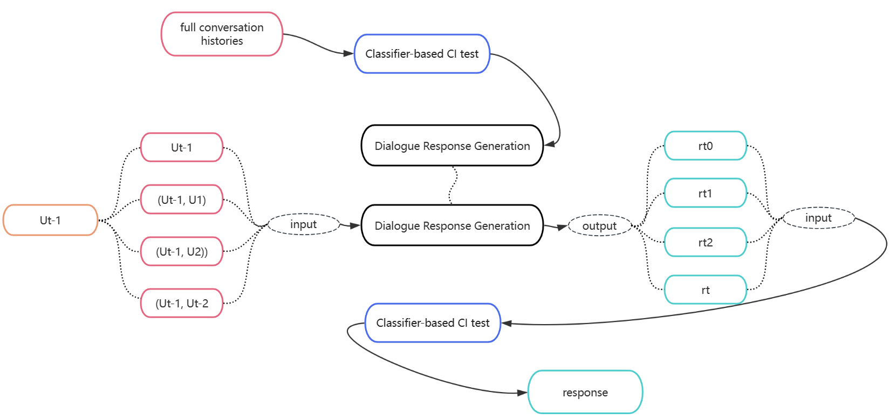
Method
Training and inference processes:

Slide 12
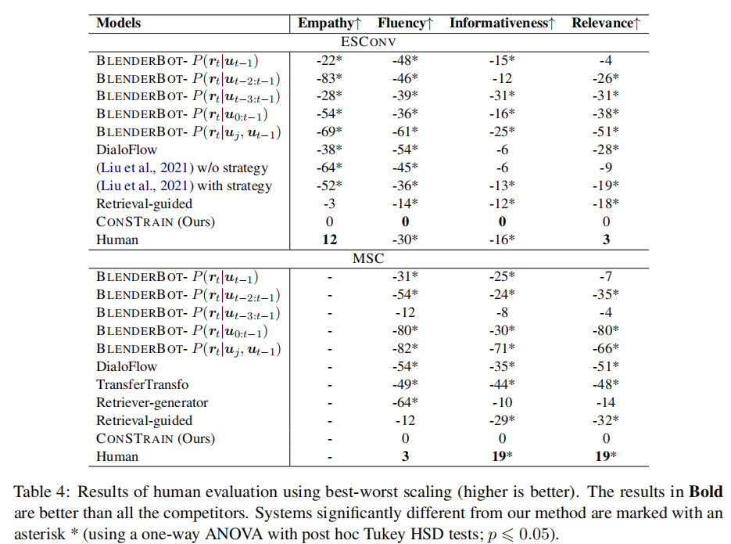
Conclusion

Slide 13
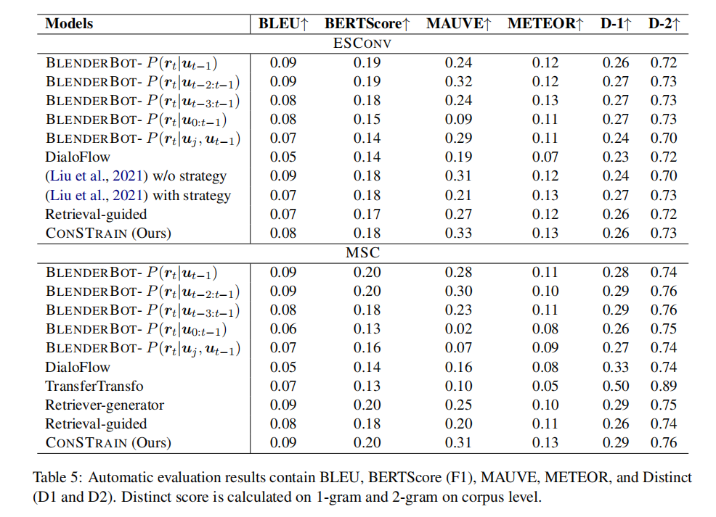
Conclusion

Slide 14
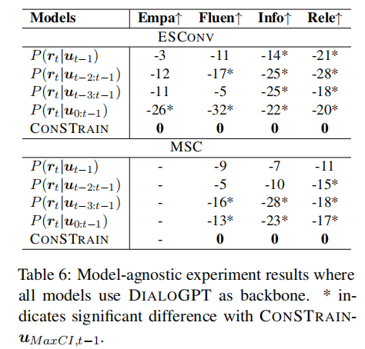
Conclusion

Slide 15
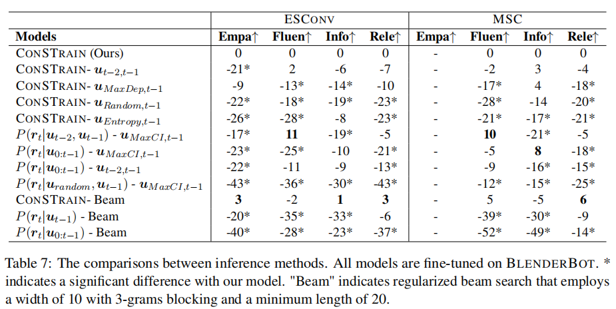
Conclusion

Slide 16
Conclusion
1.We conduct the first empirical study on spurious correlations for dialogue response generation models.
2.propose a constrained self-training method,coined CONSTRAIN, to train the corresponding classifier.
3.We propose to train response generationmodels by taking only direct causes as inputs and perform inference using the CI classifier.

